Slide 1
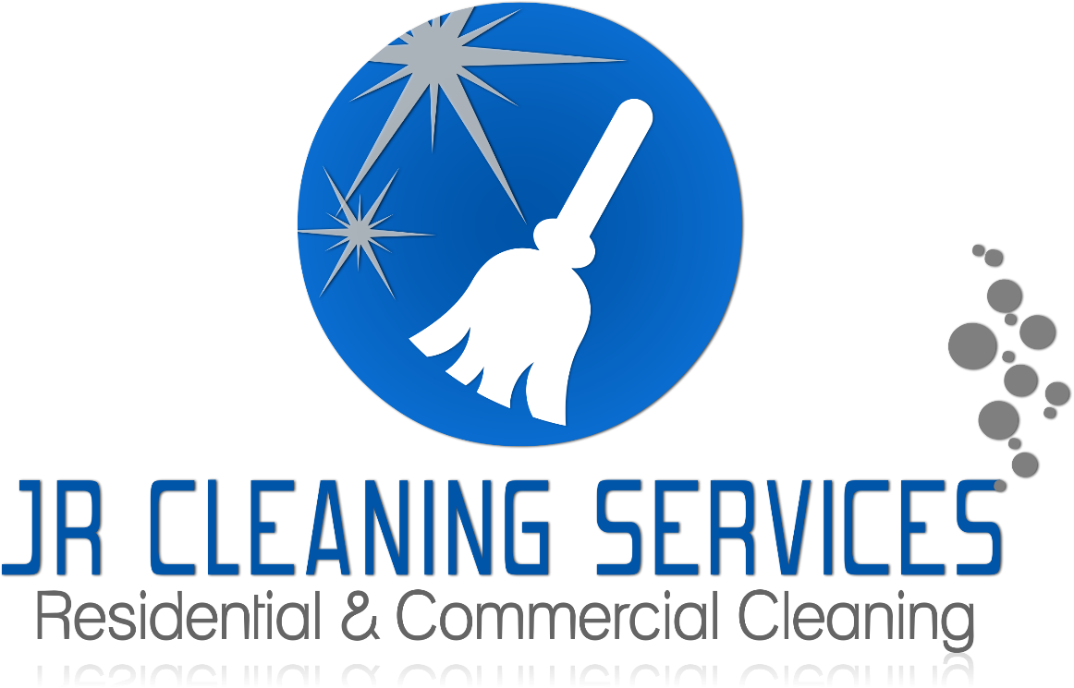

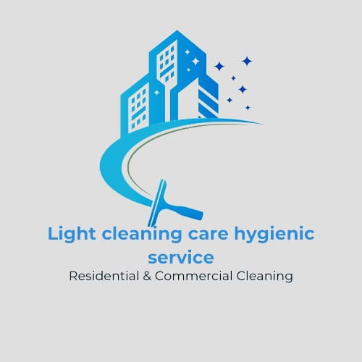
CompanyProfile

Slide 2

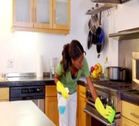

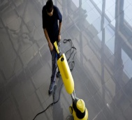

Overview
Specialised Welding
About Us
light Cleaning care hygienic is a competent black owned and managed company specializing in residential and commercial cleaning.
We are fully prepared and equipped to undertake large-scale projects that will surpass our clients' expectations. Our management team possesses extensive expertise and experience within the cleaning industry.
Our offices are centrally located in the economic hub of Midrand, Vorna valley Gauteng, Province.
2
2

Slide 3

Company Introduction
Light Cleaning Care Hygienic Servicess:Our company promises to deliver genuine and enduring solutions for all your cleaning service requirements. We can tackle a multitude of your everyday cleaning and operational challenges, allowing you to concentrate on your fundamental business endeavors.
Taking care of all your cleaning services by way of regular contract cleaning
Outsourcing your wash bay with a fully-trained and supervised team
Ensuring your staff are trained to top-class SETA-approved standards
Having someone expertly take care of your once-off cleaning needs – such as before or
after you move premises
Providing effective hygiene services and waste disposal management
Light Cleaning is just a phone call or an email away. We take pride in offering eco-friendly, cost-effective, and long-term solutions for your daily cleaning service needs and biggest challenges.
Light Cleaning Care Hygienic Services Level 1 B-BBEE Contributor; our staff are thoroughly trained and supervised. We use green, safe and environmentally-friendly products along with the latest, effective cleaning machines to deliver the results you demand, hassle-free.
3

Slide 4
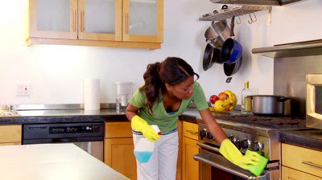
Our Mission
Light Cleaning care Hygienic is committed to providing the highest quality residential & commercial cleaning service available by exceeding the expectations of our clients, as well as their employees, patients, students, and other visitors to their premises or facilities. Our internal online management system, ensures that our team adheres to the following four major management functions:
Planning: Defining goals, establishing strategy and developing sub-plans to coordinate activities through a flexible management approach.
Quality of Work: Delivering consistently clean and sanitary spaces, meeting agreed-upon standards, and addressing customer needs are key indicators of reliable services .
Consistency: Regular, on-time cleaning appointements are essential for maintaining a consistent level of cleanliness and building customer trust.
Controlling: regular audits and maintenance activities are executed to ensure that tasks are accomplished as planned, with outcomes reviewed and evaluated with the aim of continuous improvement.
Our Vision
We strive to position ourselves as the most respected and sought-after contract cleaning and facilities support service provider in South Africa. We aim to foster a partnership philosophy predicated on robust and trustworthy relationships with our key stakeholders.
4
3

Slide 5
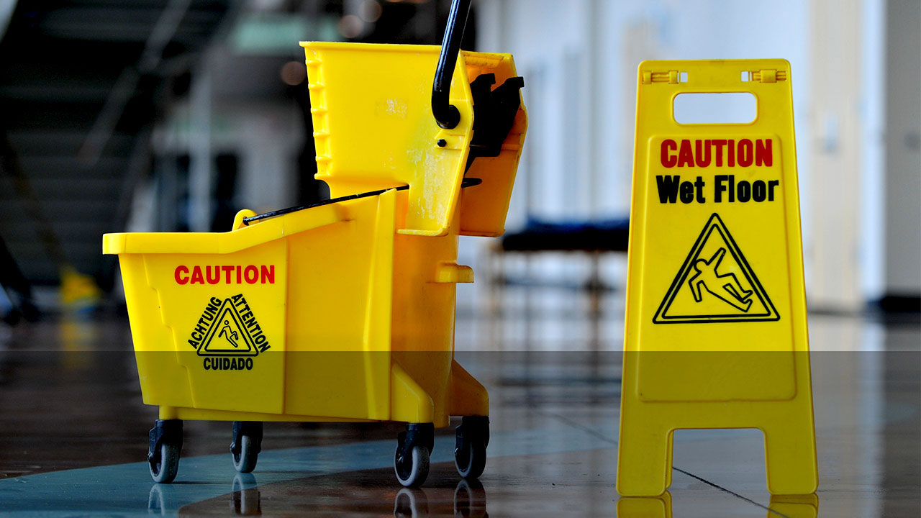
Our Services
Light Cleaning Care Hygienic Services is committed to providing exceptional cleaning services that exceed industry standards. Our team of experienced professionals is dedicated to maintaining the highest levels of cleanliness, hygiene, and safety for our clients. We offer a comprehensive suite of services, including office cleaning, industrial cleaning, and specialized cleaning solutions, all tailored to meet the unique needs of our commercial and industrial clients. Our company's mission is to create a clean, healthy, and productive environment that supports the success of our clients' businesses. We take pride in our attention to detail, our commitment to sustainability, and our unwavering focus on customer satisfaction.
We offer a full range of Professional Services, Including:
√ Contract Cleaning Services √ Move-in/ Move-out
√ Once-off Cleaning √ Taining
√ Industrial Cleaning
√ Commercial Cleaning
√ Waste Management
Our Commitments
To conduct business in a respective and caring way towards all people.
To improve our safety, health and environment performance.
To comply with all applicable legal and agreed requirements.
To promote co-operation with clients to ensure health and safety at all sites.
To employ technology and methods at all times to ensure an inherent safer work.
To actively share the vision of a safe and healthy work place and environment.
5

Slide 6

Our Values
Respect
Appreciating and Honoring each individual’s decisions and perspectives.
Responsibility
Acting with integrity towards our staff, our customers, the community and the environment
Caring
A duty of care for our staff, customers and the environment.
Excellence
Strive to consistently deliver exceptional cleaning services and outstanding customer experiences.
Integrity
To act with honesty, openness and follow trough on commitments.
Innovation
Maintaining Standars and saving Time .
Cleaning Objectives
Our key objectives, fundamental to our business in delivering you world-class cleaning and customer service, are as follows:
Provide our customers with a professional and friendly service.
Meet or exceed the expectations of the management, staff and those visiting our clients
office, building or facilities.
Implement our Total Quality Management System based on ISO9001, Quality AS4801
Safety & IS014001 Environment through our innovative Integrated Management System.
6

Slide 7
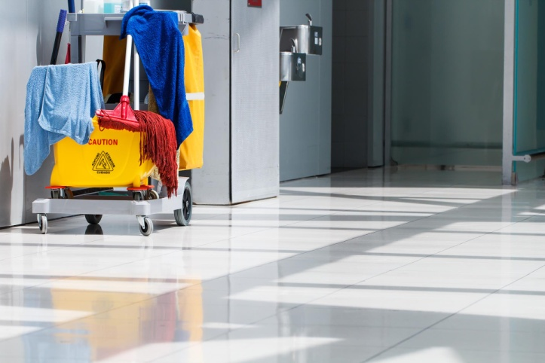
Health and Safety
Light Cleaning Care Hygienic Service is committed to providing safe and healthful working conditions and implementing safe work practices that protect employees and others at our work locations. We believe that safety is a value that is very important to all of us. There is no cleaning task or work process that is so important that we cannot devote the necessary time and resources to do it safely.
We recognize that accident prevention, productivity, and quality of performance go hand in hand, and that safety is an integral part of all activities. All employees, regardless of the capacity in which they work, assume responsibility for safety awareness and consciousness. This responsibility is met by maintaining safe conditions and performing duties in accordance with safe work practices. We all play a significant role in looking out for ourselves and others.
Environmental Policy
Light Cleaning Care Hygienic Services is committed to environmental responsibility. This policy establishes a framework to promote an eco-friendly approach to our cleaning services, fostering a safe and healthy work environment. As an employer, we recognize the potential environmental impact of our business, particularly from cleaning materials. As these are under our direct control, it is our policy to minimize the use of harmful products and utilize eco-friendly alternatives wherever possible.
7

Slide 8



Contact Person: JACOB MATAZI
Position: DIRECTOR
Mobile: 0620318208
Physical Address:
46 PRETORIUS Rd Vorna Valley
1685 MIDRAND

